Slide 1
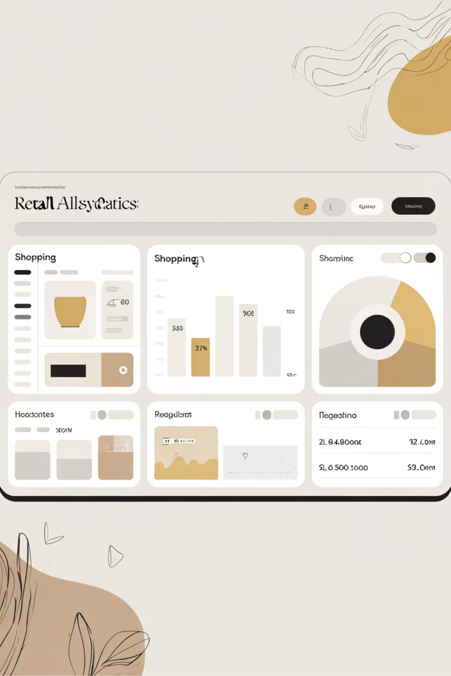
Customer Shopping Behavior Analysis
Uncovering insights from 3,900 purchases to guide strategic business decisions

Slide 2
Dataset Overview
3,900
18
50
25
Total Purchases
Data Columns
Locations
Product Types
Transactions analyzed across all categories
Comprehensive customer and purchase attributes
Geographic diversity in customer base
Wide variety of items purchased
Key Features
Data Quality
Customer demographics & location
Clean dataset with only 37 missing values in Review Rating column, handled through median imputation by category.
Purchase details & amounts
Shopping behavior patterns
Review ratings & shipping preferences

Slide 3
Data Preparation Process
01
02
03
Data Loading & Exploration
Missing Data Handling
Feature Engineering
Imported dataset, checked structure and summary statistics
Imputed Review Rating nulls using median by category
Created age_group and purchase_frequency_days columns
04
05
Data Consistency
Database Integration
Standardized columns, removed redundant promo_code_used field
Connected to PostgreSQL for advanced SQL analysis

Slide 4

Key Statistical Insights
Customer Profile
Purchase Behavior
Engagement
Avg Previous Purchases: 25
Average Age: 44 years
Avg Amount: $59.76
Subscription Rate: 27%
Age Range: 18-70 years
Range: $20-$100
Avg Rating: 3.75/5.0
Discount Usage: 43%
Gender Split: 68% Male, 32% Female

Slide 5
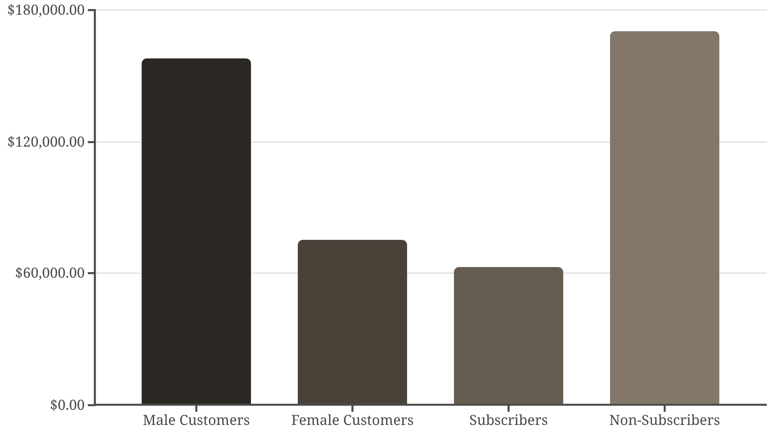
Revenue Analysis
Gender Gap
Subscription Paradox
Male customers generate 2.1x more revenue than female customers
Non-subscribers contribute 73% of total revenue despite lower avg spend

Slide 6
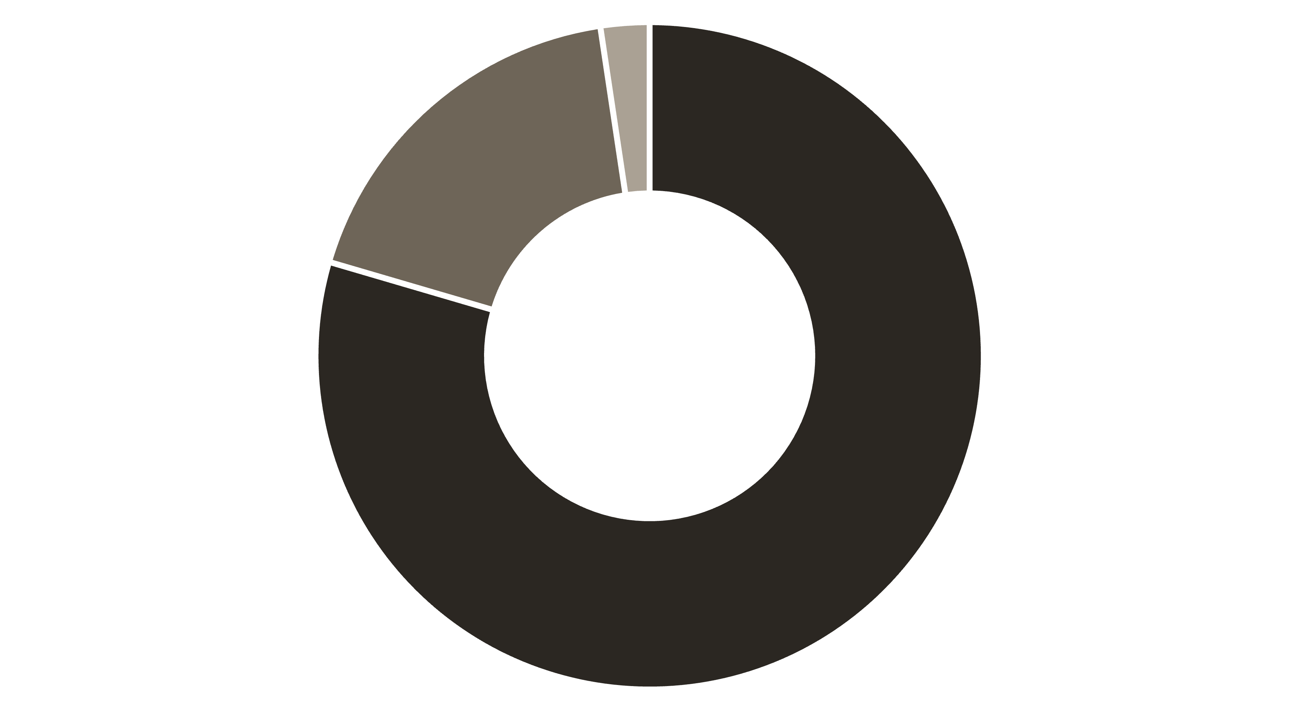
Customer Segmentation
Loyal
Returning
New
Segment Breakdown
Subscription Correlation
Loyal (80%): Repeat buyers with 5+ purchases
Among repeat buyers (>5 purchases): 958 are subscribers vs 2,518 non-subscribers
Returning (18%): 2-4 previous purchases
Opportunity to convert loyal customers into subscribers
New (2%): First-time customers

Slide 7
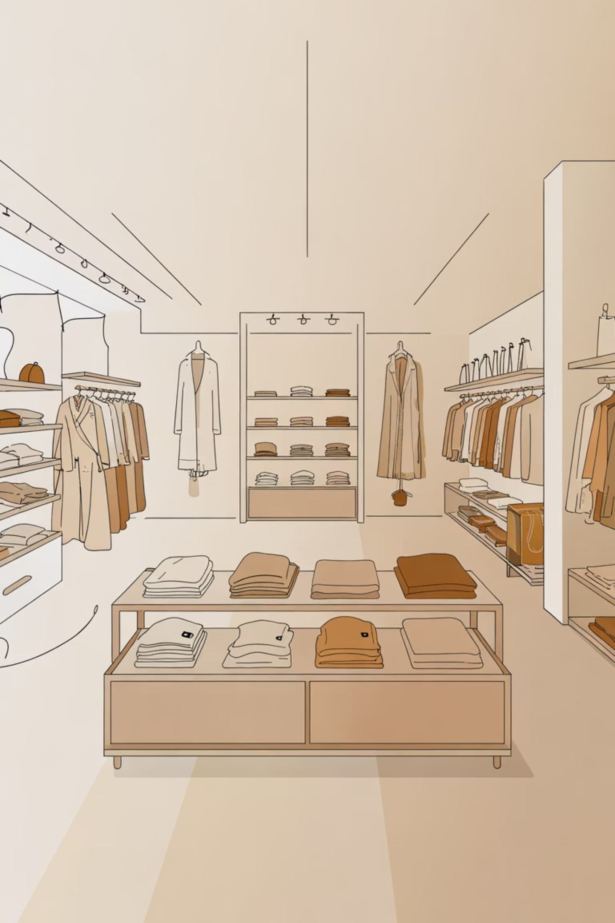
Product Performance
Top-Rated Products
1
Gloves (3.86), Sandals (3.84), Boots (3.82)
Best-Selling by Category
Clothing: Blouse, Pants, Shirt
2
Footwear: Sandals, Shoes, Sneakers
Accessories: Jewelry, Sunglasses, Belt
Discount-Dependent Items
3
Hat (50%), Sneakers (49.7%), Coat (49.1%)

Slide 8
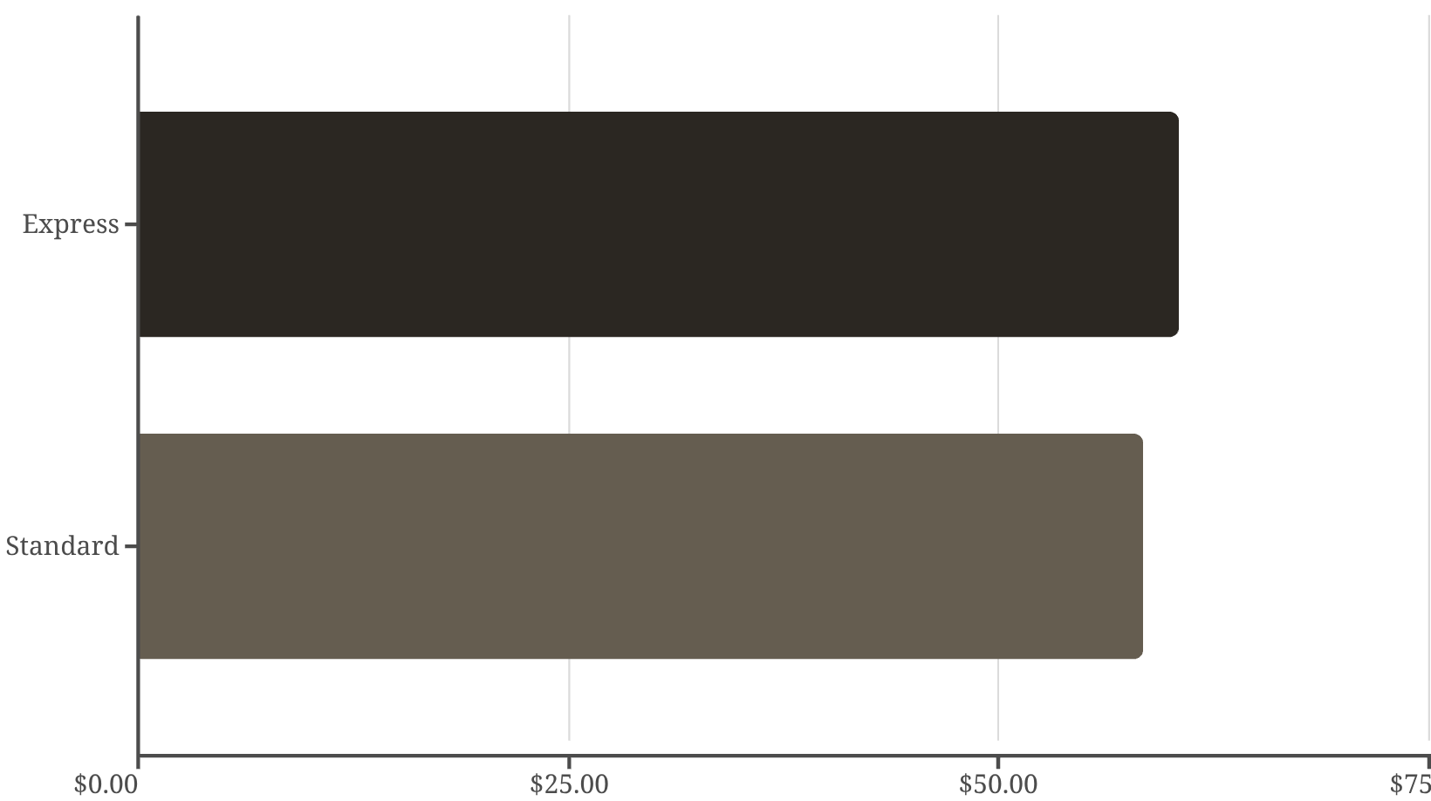
Shipping & Discount Insights
Shipping Type Impact
High-Value Discount Users
839 customers used discounts but still spent above average ($59.76)
These savvy shoppers represent opportunity for targeted promotions
Express shipping users spend $2 more on average

Slide 9
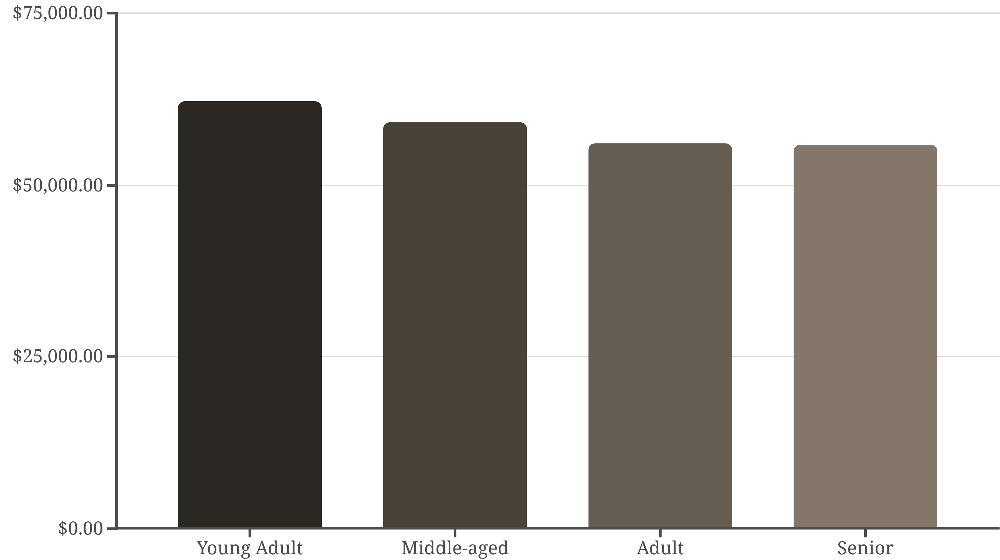
Age Group Revenue Distribution
Revenue relatively balanced across age groups, with Young Adults leading at $62,143

Slide 10

Strategic Recommendations
Boost Subscriptions
Loyalty Programs
Optimize Discounts
Promote exclusive benefits to convert loyal customers—958 repeat buyers already subscribed
Reward returning customers to accelerate movement into loyal segment
Balance sales boosts with margin control—some products 50% discount-dependent
Product Positioning
Targeted Marketing
Highlight top-rated items (Gloves, Sandals, Boots) in marketing campaigns
Focus on Young Adults and express-shipping users for premium offerings

